Slide 1
CARDIOVASCULAR SYSTEM
KMTC LECTURE SERIES

Slide 2
The Thorax
The thorax is the region between the abdomen inferiorly and the root of the neck superiorly.
It forms from the thoracic wall, its superficial structures (breast, muscles, and skin) and the thoracic cavity.
Thoracic Wall
The thoracic wall is formed by 12 ribs, 12 thoracic vertebrae, cartilage, sternum, and five muscles.
It functions in movement, respiration, and protection of the thoracic cavity

Slide 3
The thoracic vertebral bodies and intervertebral discs make the posterior thoracic wall.
Each rib articulates with two concurrent vertebral bodies and curves laterally, anteriorly, and inferiorly.
The first seven true ribs articulate with the sternum anteriorly, false ribs 8 to 10 have cartilaginous extensions to communicate with the sternum while floating ribs 11 and 12 do not communicate with the sternum, forming the bony framework of the thoracic wall

Slide 4
Muscles of the thoracic wall
From superficial to deep, muscles of the thoracic wall are:
External intercostal
Internal intercostal
Innermost intercostal
Subcostalis (posteriorly)
Transversus thoracis muscle (anteriorly).

Slide 5
Thoracic Cavity
The thoracic cavity is found deep to the thoracic wall, superior to the diaphragm, and inferior to the root of the neck (thoracic aperture).
The thoracic cavity contains organs and tissues that function in the:-
Respiratory (lungs, bronchi, trachea, pleura),
Cardiovascular (heart, pericardium, great vessels, lymphatics),

Slide 6
Nervous (vagus nerve, sympathetic chain, phrenic nerve, recurrent laryngeal nerve)
Immune (thymus)
Digestive (esophagus) systems

Slide 7
The thoracic cavity can typically be divided into well-established compartments:-
The pleural cavities(respectively contain the left and right lungs and pleura
The mediastinum(central and found between the two bilateral pleural cavities).

Slide 8
The mediastinum
The mediastinum extends to the inner border of the sternum anteriorly, the inner border of the thoracic vertebral bodies posteriorly, and spans the full vertical length of the thoracic cavity.
The mediastinum is divided into superior and inferior mediastinum by a horizontal plane (thoracic plane) passing through the angle of the manubrium and the body of sternum crossing through T3-t4 vertebral junction.

Slide 9
The inferior mediastinum further subdivides into anterior, middle, and posterior compartments by the anterior and posterior surfaces of the pericardium.
The anterior mediastinum is anterior to the pericardial sac, the middle mediastinum contains the heart and pericardium, and the posterior mediastinum is posterior to the pericardial sac.

Slide 10
Gross contents of each mediastinal compartment
Pleural cavities - lungs and pleura
Superior mediastinum - great vessels, trachea, esophagus, vagus nerve, phrenic nerve, sympathetic nerves, thoracic lymphatic duct, thymus
Anterior mediastinum - connective tissue, thymus, and lymph nodes
Middle mediastinum - heart, roots of great vessels, phrenic nerve, and pericardium

Slide 11
Posterior mediastinum - descending aorta, azygos veins, esophagus, vagus nerve, sympathetic nerves, bronchi, and thoracic lymphatic duct

Slide 12
Heart Anatomy
Approximately the size of your fist
Location
  Within the middle mediastinum
  Superior surface of diaphragm
  Left of the midline
  Anterior to the vertebral column, posterior to the sternum
Notes:
Chapter 18, Cardiovascular System

Slide 13
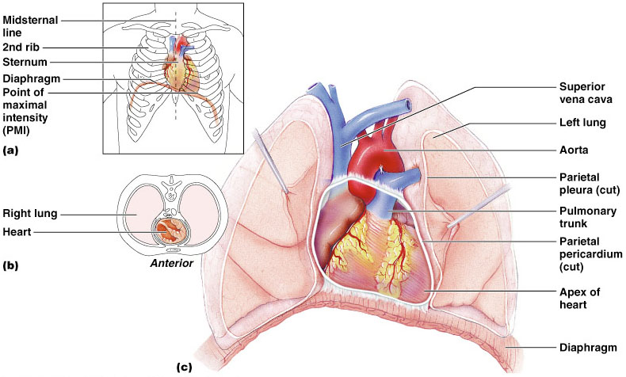
Heart Anatomy
Notes:
Chapter 18, Cardiovascular System

Slide 14
Coverings of the Heart: Anatomy
Pericardium – a double-walled sac around the heart composed of:
  A superficial fibrous pericardium
  A deep two-layer serous pericardium
    The parietal layer lines the internal surface of the fibrous pericardium
    The visceral layer or epicardium lines the surface of the heart
    They are separated by the fluid-filled pericardial cavity
Notes:
Chapter 18, Cardiovascular System

Slide 15
Coverings of the Heart
The Function of the Pericardium:
  Protects and anchors the heart
  Prevents overfilling of the heart with blood
  Allows for the heart to work in a relatively friction-free environment
Notes:
Chapter 18, Cardiovascular System

Slide 16
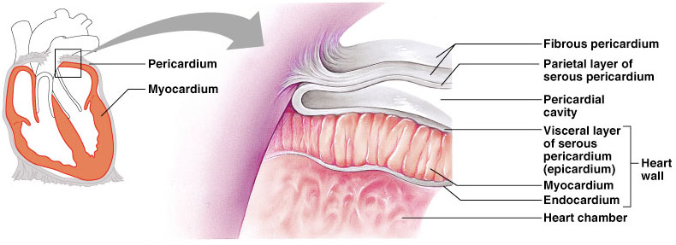
Pericardial Layers of the Heart
Chapter 18, Cardiovascular System
Figure 18.2
Notes:
Chapter 18, Cardiovascular System

Slide 17
Heart Wall
Epicardium – visceral layer of the serous pericardium
Myocardium – cardiac muscle layer forming the bulk of the heart
Fibrous skeleton of the heart – crisscrossing, interlacing layer of connective tissue
Endocardium – endothelial layer of the inner myocardial surface
Notes:
Chapter 18, Cardiovascular System

Slide 18
External Heart: Major Vessels of the Heart (Anterior View)
Vessels returning blood to the heart include:
  Superior and inferior venae cavae
  Right and left pulmonary veins
Vessels conveying blood away from the heart include:
  Pulmonary trunk, which splits into right and left pulmonary arteries
  Ascending aorta (three branches) –
    Brachiocephalic
    Left & Right common carotid
    Subclavian arteries
Chapter 18, Cardiovascular System
Notes:
Chapter 18, Cardiovascular System

Slide 19
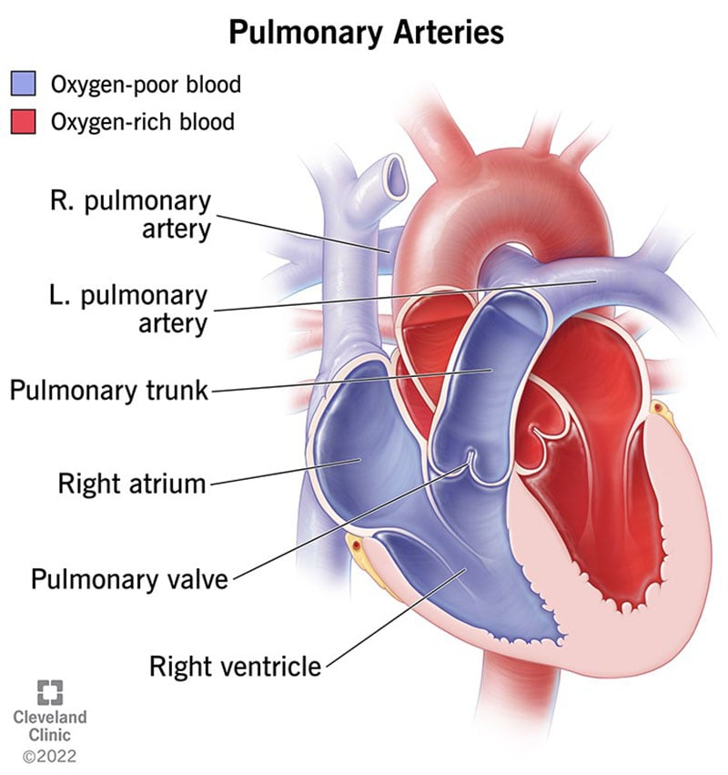

Slide 20
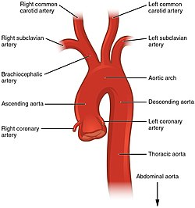

Slide 21
External Heart: Vessels that Supply/Drain the Heart (Anterior View)
Arteries – right and left coronary (in atrioventricular groove), marginal, circumflex, and anterior interventricular arteries
Veins – small cardiac, anterior cardiac, and great cardiac veins
Chapter 18, Cardiovascular System
Notes:
Chapter 18, Cardiovascular System

Slide 22
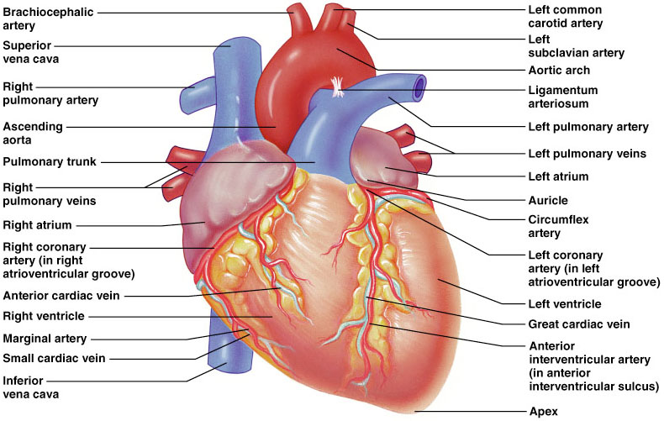
External Heart: Anterior View
Chapter 18, Cardiovascular System
Figure 18.4b
Notes:
Chapter 18, Cardiovascular System

Slide 23
External Heart: Major Vessels of the Heart (Posterior View)
Vessels returning blood to the heart include:
  Right and left pulmonary veins
  Superior and inferior venae cavae
Vessels conveying blood away from the heart include:
  Aorta
  Right and left pulmonary arteries
Chapter 18, Cardiovascular System
Notes:
Chapter 18, Cardiovascular System

Slide 24
External Heart: Vessels that Supply/Drain the Heart (Posterior View)
Arteries – right coronary artery (in atrioventricular groove) and the posterior interventricular artery (in interventricular groove)
Veins – great cardiac vein, posterior vein to left ventricle, coronary sinus, and middle cardiac vein
Notes:
Chapter 18, Cardiovascular System

Slide 25
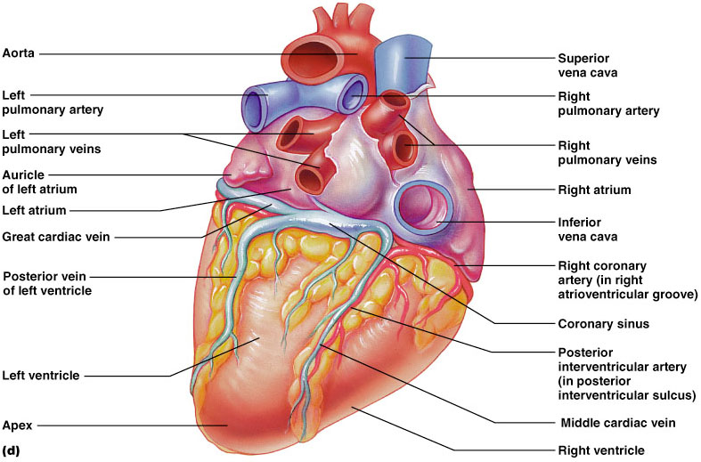
External Heart: Posterior View
Chapter 18, Cardiovascular System
Figure 18.4d
Notes:
Chapter 18, Cardiovascular System

Slide 26
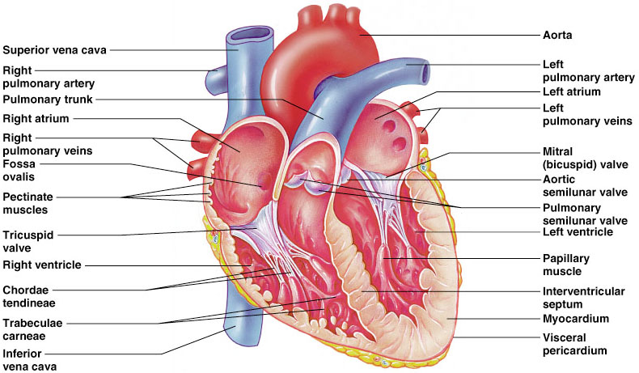
Gross Anatomy of Heart: Frontal Section
Chapter 18, Cardiovascular System
Figure 18.4e
Notes:
Chapter 18, Cardiovascular System

Slide 27
Atria of the Heart
Atria are the receiving chambers of the heart
Each atrium has a protruding auricle
Pectinate muscles mark atrial walls
Blood enters right atria from superior and inferior venae cavae and coronary sinus
Blood enters left atria from pulmonary veins
Notes:
Chapter 18, Cardiovascular System

Slide 28
Ventricles of the Heart
Ventricles are the discharging chambers of the heart
Papillary muscles and trabeculae carneae muscles mark ventricular walls
Right ventricle pumps blood into the pulmonary trunk
Left ventricle pumps blood into the aorta
Notes:
Chapter 18, Cardiovascular System

Slide 29
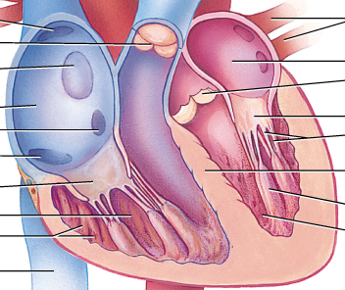
Myocardial Thickness and Function
Thickness of myocardium varies according to the function of the chamber
Atria are thin walled, deliver blood to adjacent ventricles
Ventricle walls are much thicker and stronger
  right ventricle supplies blood to the lungs (little flow resistance)
  left ventricle wall is the thickest to supply systemic circulation
Notes:
Chapter 18, Cardiovascular System

Slide 30
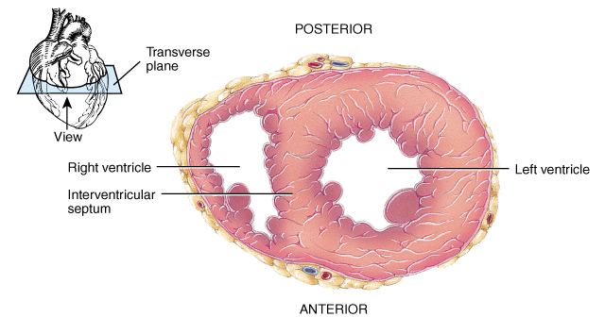
Thickness of Cardiac Walls
Myocardium of left ventricle is much thicker than the right.
Notes:
Chapter 18, Cardiovascular System

Slide 31
Pathway of Blood Through the Heart and Lungs
Right atrium → tricuspid valve → right ventricle
Right ventricle → pulmonary semilunar valve → pulmonary arteries → lungs
Lungs → pulmonary veins → left atrium
Left atrium → bicuspid valve → left ventricle
Left ventricle → aortic semilunar valve → aorta
Aorta → systemic circulation
Chapter 18, Cardiovascular System
Notes:
Chapter 18, Cardiovascular System

Slide 32
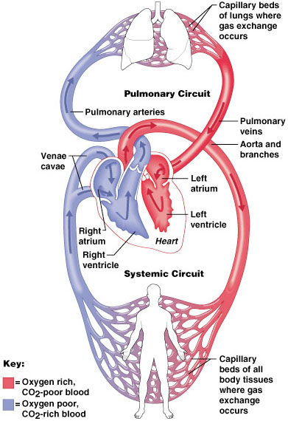
Pathway of Blood Through the Heart and Lungs
Chapter 18, Cardiovascular System
Figure 18.5
Notes:
Chapter 18, Cardiovascular System

Slide 33
Coronary Circulation
Coronary circulation is the functional blood supply to the heart muscle itself
Collateral routes ensure blood delivery to heart even if major vessels are occluded
Chapter 18, Cardiovascular System
Notes:
Chapter 18, Cardiovascular System

Slide 34
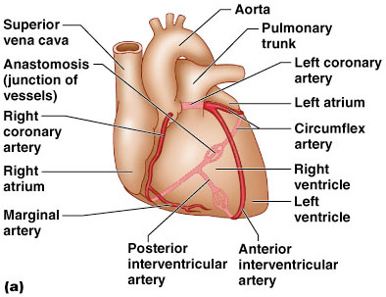
Coronary Circulation: Arterial Supply
Chapter 18, Cardiovascular System
Figure 18.7a
Notes:
Chapter 18, Cardiovascular System

Slide 35
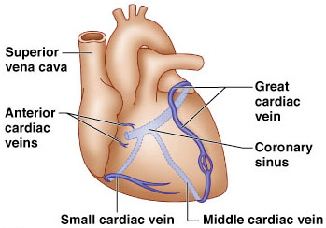
Coronary Circulation: Venous Supply
Chapter 18, Cardiovascular System
Figure 18.7b
Notes:
Chapter 18, Cardiovascular System

Slide 36
Coronary Circulation
The heart is supplied by two coronary arteries:
the left main coronary artery(80%)
the right coronary artery.

Slide 37
lymphatic drainage
Small lymphatic vessels form a dense network beneath the epicardium and endocardium of the ventricles and open into a lymphatic duct in the atrioventricular groove

Slide 38
Heart Valves
Heart valves ensure unidirectional blood flow through the heart
Atrioventricular (AV) valves lie between the atria and the ventricles
  AV valves prevent backflow into the atria when ventricles contract
Chordae tendineae anchor AV valves to papillary muscles
Chapter 18, Cardiovascular System
Notes:
Chapter 18, Cardiovascular System

Slide 39
Heart Valves
Semilunar valves prevent backflow of blood into the ventricles
Aortic semilunar valve lies between the left ventricle and the aorta
Pulmonary semilunar valve lies between the right ventricle and pulmonary trunk
Chapter 18, Cardiovascular System
Notes:
Chapter 18, Cardiovascular System

Slide 40
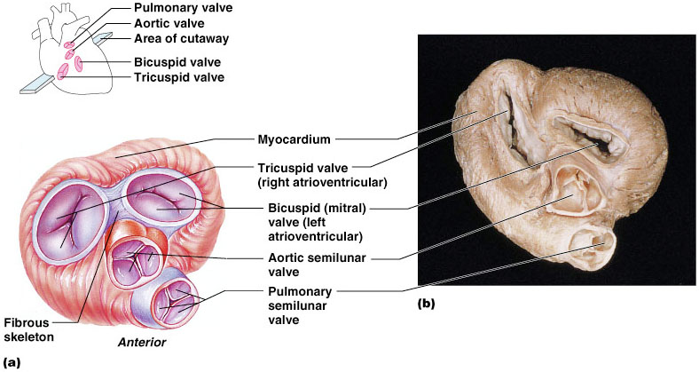
Heart Valves
Chapter 18, Cardiovascular System
Figure 18.8a, b
Notes:
Chapter 18, Cardiovascular System

Slide 41
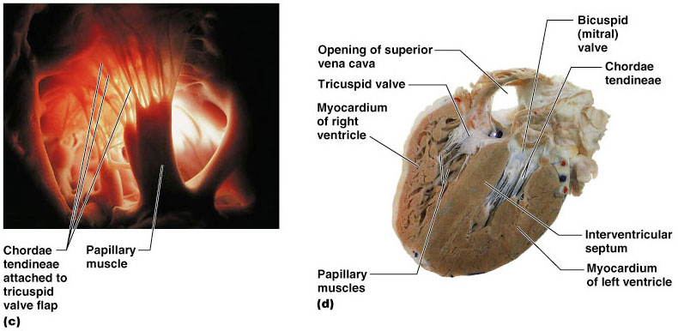
Heart Valves
Chapter 18, Cardiovascular System
Figure 18.8c, d
Notes:
Chapter 18, Cardiovascular System

Slide 42
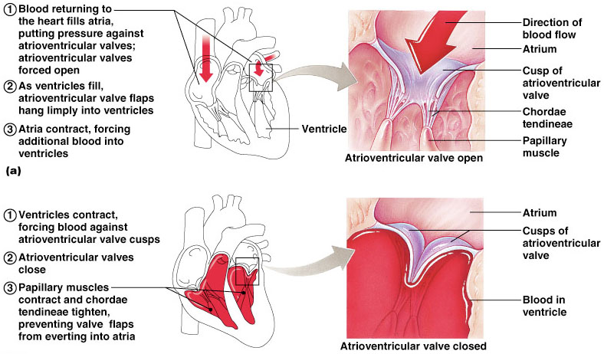
Atrioventricular Valve Function
Chapter 18, Cardiovascular System
Figure 18.9
Notes:
Chapter 18, Cardiovascular System

Slide 43
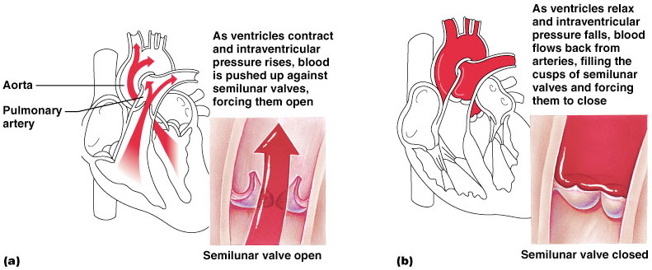
Semilunar Valve Function
Chapter 18, Cardiovascular System
Figure 18.10
Notes:
Chapter 18, Cardiovascular System

Slide 44
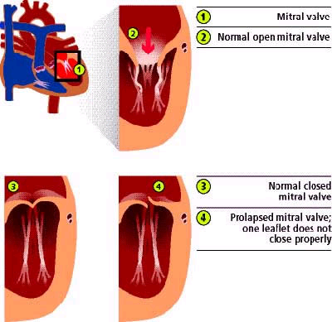
Mitral Valve Prolapse
Chapter 18, Cardiovascular System
Notes:
Chapter 18, Cardiovascular System

Slide 45
Microscopic Anatomy of Heart Muscle
Cardiac muscle is striated, short, fat, branched, and interconnected
The connective tissue endomysium acts as both tendon and insertion
Intercalated discs anchor cardiac cells together and allow free passage of ions
Heart muscle behaves as a functional syncytium
PLAY
InterActive Physiology®:
Cardiovascular System: Anatomy Review: The Heart
Chapter 18, Cardiovascular System
Notes:
Chapter 18, Cardiovascular System

Slide 46
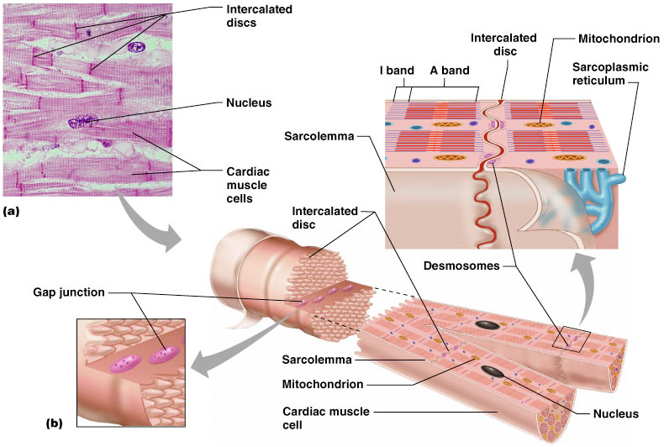
Microscopic Anatomy of Heart Muscle
Chapter 18, Cardiovascular System
Figure 18.11
Notes:
Chapter 18, Cardiovascular System

Slide 47
The cardiac conduction system
The cardiac conduction system is a collection of nodes and specialised conduction cells that initiate and co-ordinate contraction of the heart muscle. It consists of:
Sinoatrial node
Atrioventricular node
Atrioventricular bundle (bundle of His)
Purkinje fibres

Slide 48
The sinoatrial (SA) node is a collection of specialised cells (pacemaker cells)-Rt Atrium
The atrioventricular node – located within the atrioventricular septum, near the opening of the coronary sinus.
The atrioventricular bundle (bundle of His) is a continuation of the specialised tissue of the AV node, and serves to transmit the electrical impulse from the AV node to the Purkinje fibres of the ventricles

Slide 49
Right bundle branch – conducts the impulse to the Purkinje fibres of the right ventricle
Left bundle branch – conducts the impulse to the Purkinje fibres of the left ventricle.
The Purkinje fibres (sub-endocardial plexus of conduction cells) are a network of specialised cells. They are abundant with glycogen and have extensive gap junctions.

Slide 50
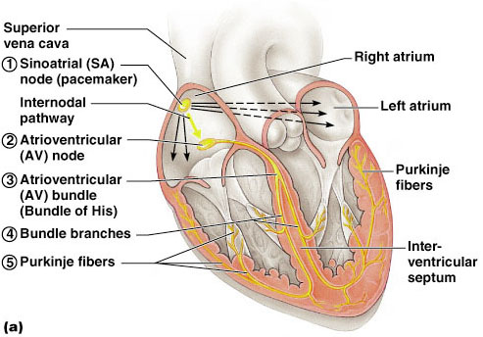
Heart Physiology: Sequence of Excitation
Chapter 18, Cardiovascular System
Figure 18.14a
Notes:
Chapter 18, Cardiovascular System

Slide 51
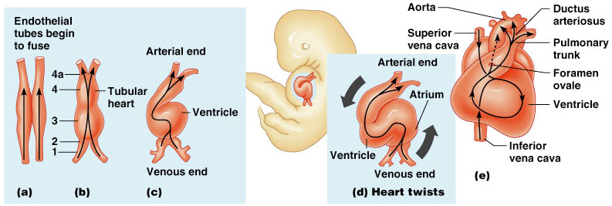
Developmental Aspects of the Heart
Chapter 18, Cardiovascular System
Figure 18.24
Notes:
Chapter 18, Cardiovascular System

Slide 52
Developmental Aspects of the Heart
Fetal heart structures that bypass pulmonary circulation
  Foramen ovale connects the two atria
  Ductus arteriosus connects pulmonary trunk and the aorta
Chapter 18, Cardiovascular System
Notes:
Chapter 18, Cardiovascular System

Slide 53
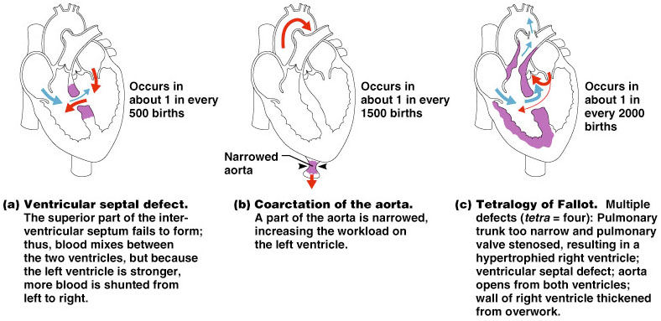
Examples of Congenital Heart Defects
Chapter 18, Cardiovascular System
Figure 18.25
Notes:
Chapter 18, Cardiovascular System

Slide 54
Age-Related Changes Affecting the Heart
Sclerosis and thickening of valve flaps
Decline in cardiac reserve
Fibrosis of cardiac muscle
Atherosclerosis
Chapter 18, Cardiovascular System
Notes:
Chapter 18, Cardiovascular System

Slide 55
Clinical Problems
MI = myocardial infarction
  death of area of heart muscle from lack of O₂
  replaced with scar tissue
  results depend on size & location of damage
Blood clot
  use clot dissolving drugs streptokinase or t-PA & heparin
  balloon angioplasty
Angina pectoris
  heart pain from ischemia (lack of blood flow and oxygen ) of cardiac muscle
Chapter 18, Cardiovascular System
Notes:
Chapter 18, Cardiovascular System

Slide 56
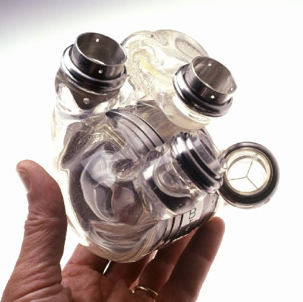
Artificial Heart
Chapter 18, Cardiovascular System
Notes:
Chapter 18, Cardiovascular System

